Slide 1

CSCI 466: Networks
Wireless Networks, WiFi
Reese Pearsall Fall 2023
https://www.cs.montana.edu/pearsall/classes/fall2023/466/main.html
*All images are stolen from the internet
1

Slide 2
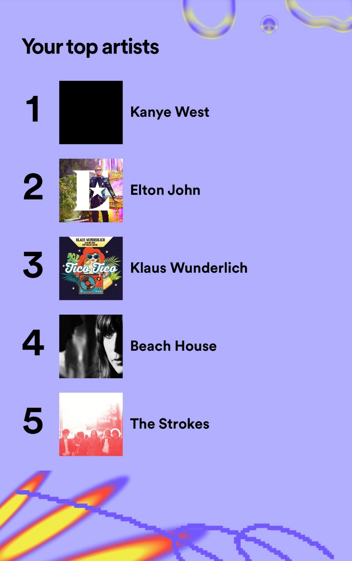
Announcements
Quiz on Friday (no class)
Message Confidentiality (Encryption)
Message Integrity and Authentication (Hashing)
Network Attacks (SYN flooding, SYN reset, SYN Hijacking, DNS attacks, BGP attacks)
Security Protocols (TLS, Ipsec, PGP)
Operational Security (Firewalls, IDS, IOCs)
Monday (12/4) → Work Day for PA5 (no lecture)
Wednesday (12/6) → Review for final exam
Friday (12/8) → Final Exam
Redacted for antisemitism reasons

Slide 3
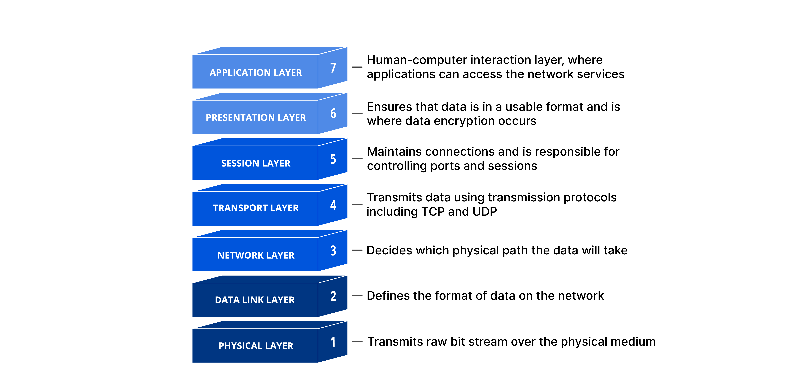


Slide 4
Wireless and Mobile Networks: context
more wireless (mobile) phone subscribers than fixed (wired) phone subscribers (10-to-1 in 2019)!
more mobile-broadband-connected devices than fixed-broadband-connected devices devices (5-1 in 2019)!
4G/5G cellular networks now embracing Internet protocol stack, including SDN
two important (but different) challenges
wireless: communication over wireless link
mobility: handling the mobile user who changes point of attachment to network

Slide 5
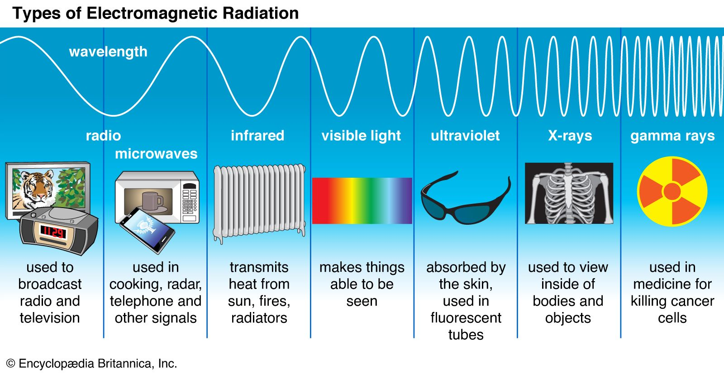
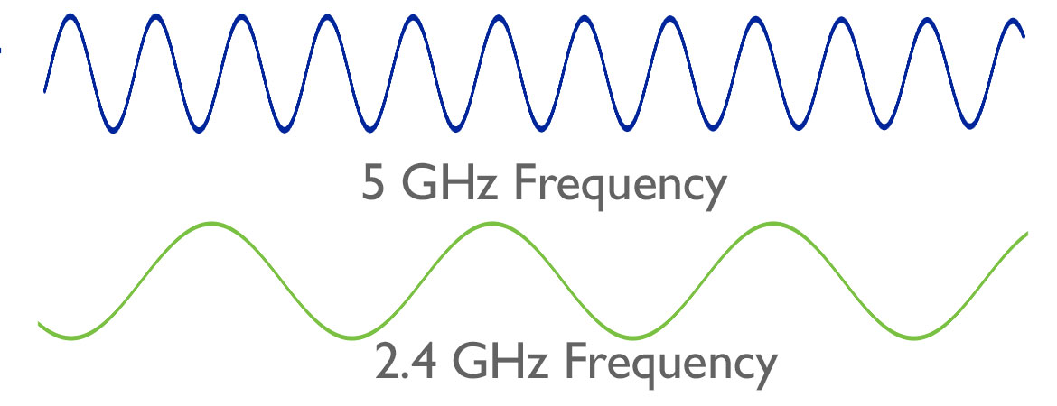
Wireless Networks
Transmission Medium = waves in the air
We can transmit waves at different frequencies
Lower frequency→ The farther the wave can travel

Slide 6
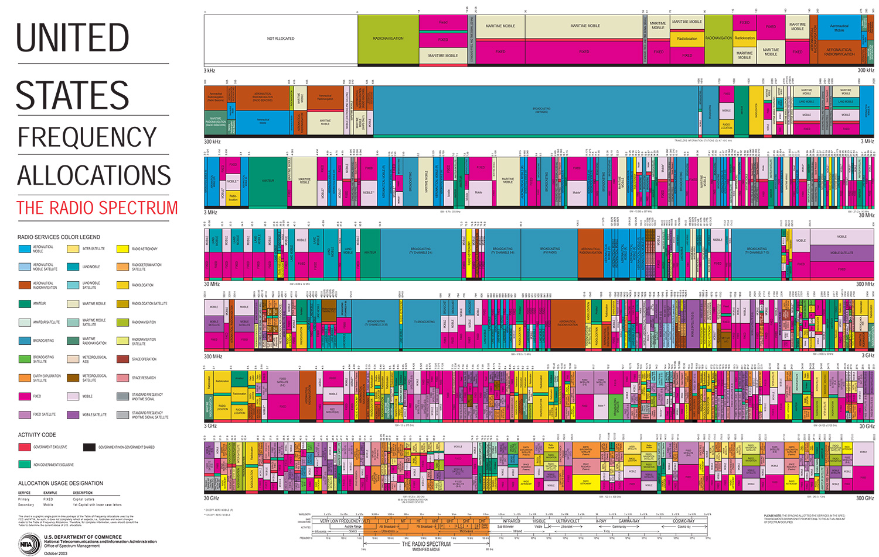
3 kHz
AM radio
300
kHz
3
MHz
30
MHz
TV
TV
TV
300
MHz
TV
TV
Cellular
WIFI
3
GHz
WIFI
30
GHz
The government controls which frequencies should be used for different technologies/services

Slide 7




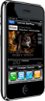















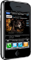




Elements of a wireless network
wireless hosts
laptop, smartphone, IoT
run applications
may be stationary (non-mobile) or mobile
wireless does not always mean mobility!
wired network
infrastructure

Slide 8

Elements of a wireless network
base station
typically connected to wired network
relay - responsible for sending packets between wired network and wireless host(s) in its “area”
e.g., cell towers, 802.11 access points
wired network
infrastructure

Slide 9
Elements of a wireless network
wireless link
typically used to connect mobile(s) to base station, also used as backbone link
multiple access protocol coordinates link access
various transmission rates and distances, frequency bands
wired network
infrastructure

Slide 10
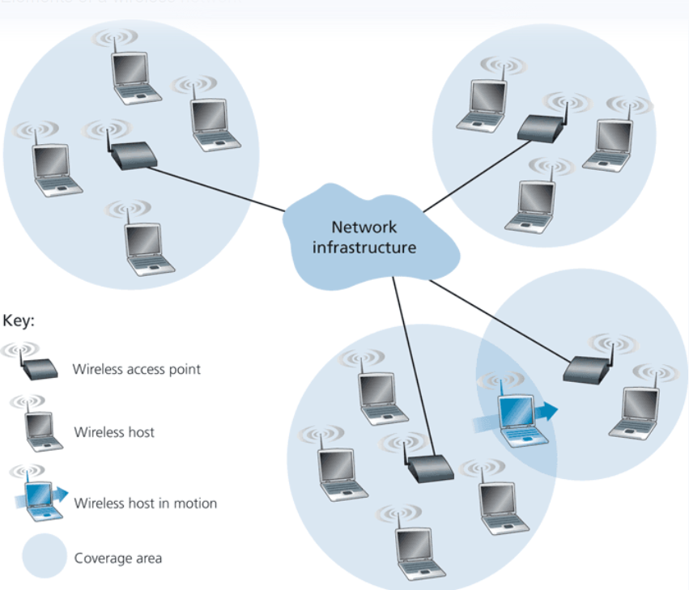
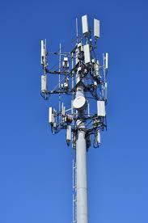
Elements of a wireless network
Wireless networks are an extension of the standard internet, and usually only occur at the network edge
(Wired)
Wireless hosts connect to a wireless access point that will connect them to the greater internet. Typically linked to a geographic location
Cell towers are the access points in cellular networks
If you are not in range of a wireless access point, you will not be able to connect to the internet

Slide 11
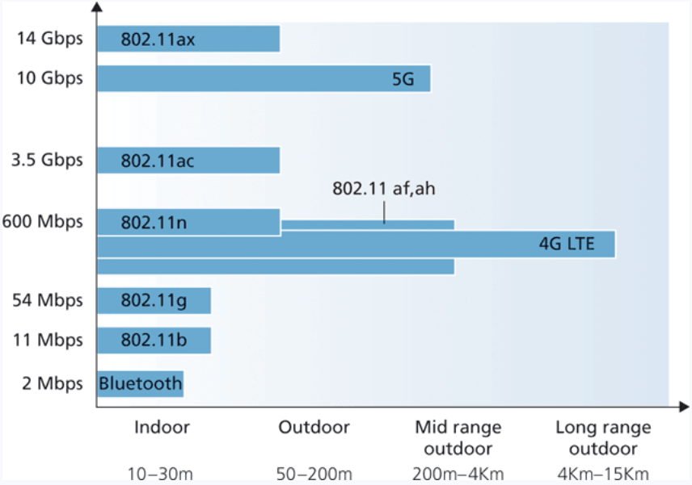
Elements of a wireless network
Easer to create high bandwidth links over high frequency carriers, but higher frequencies lose energy more rapidly and it propagates
Generally, lower frequencies are better for long distance communication
802.11 = WiFi
(These are just Wireless and wireless LAN protocols, there are many more ways!)

Slide 12
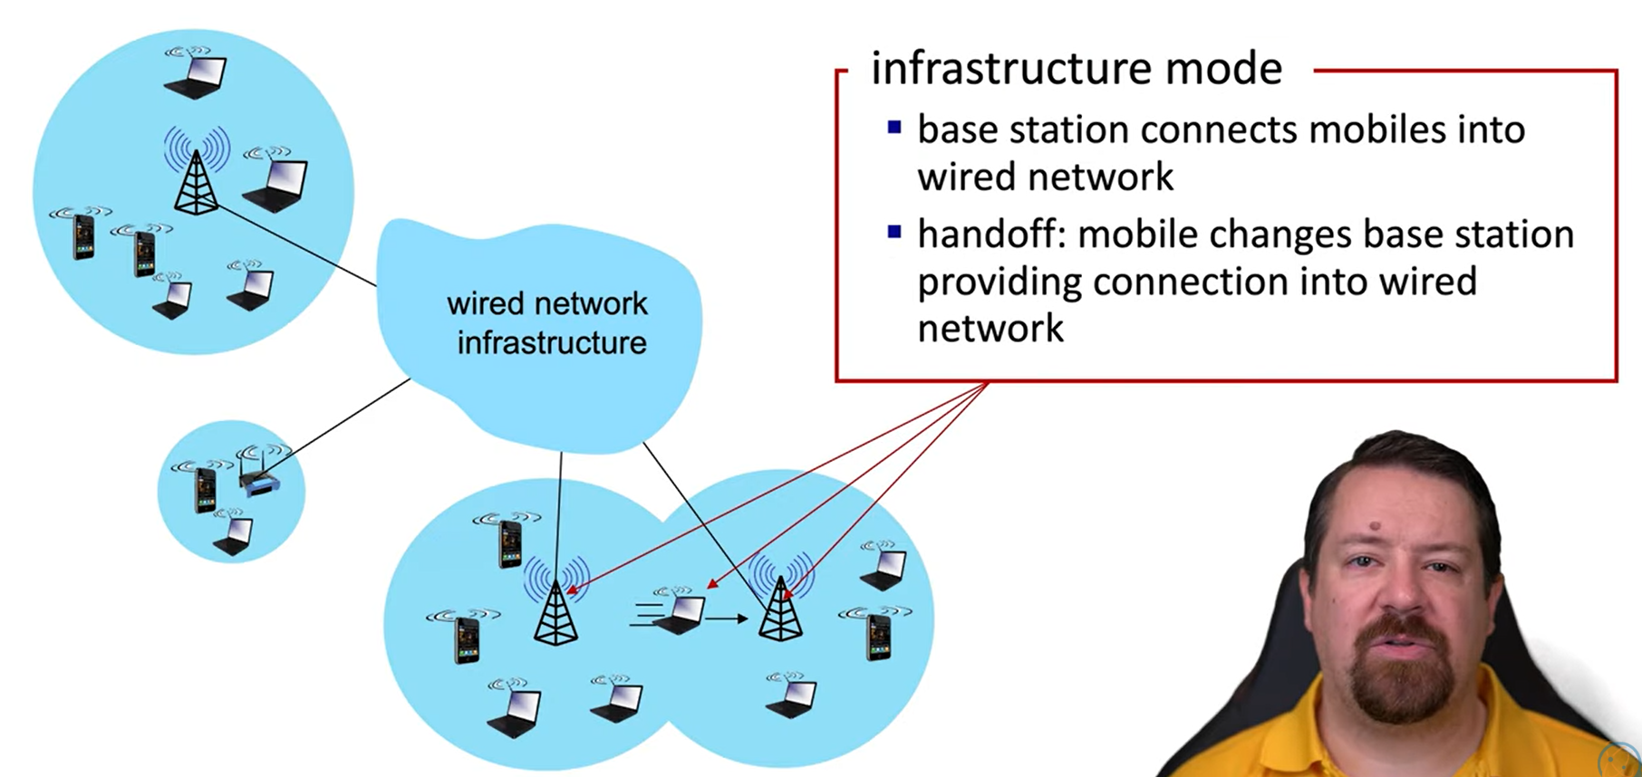
Elements of a wireless network

Slide 13
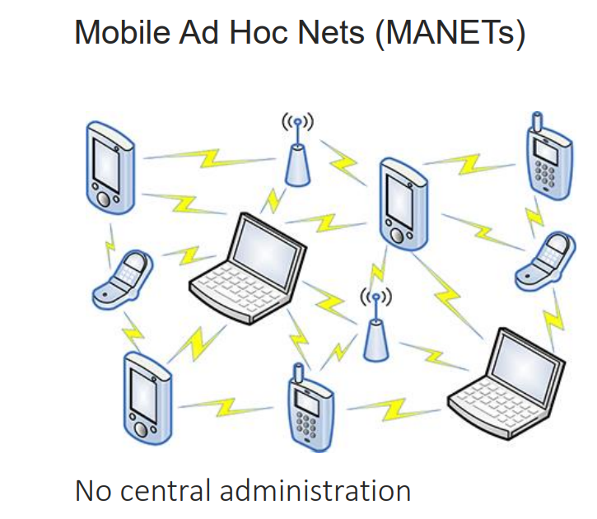
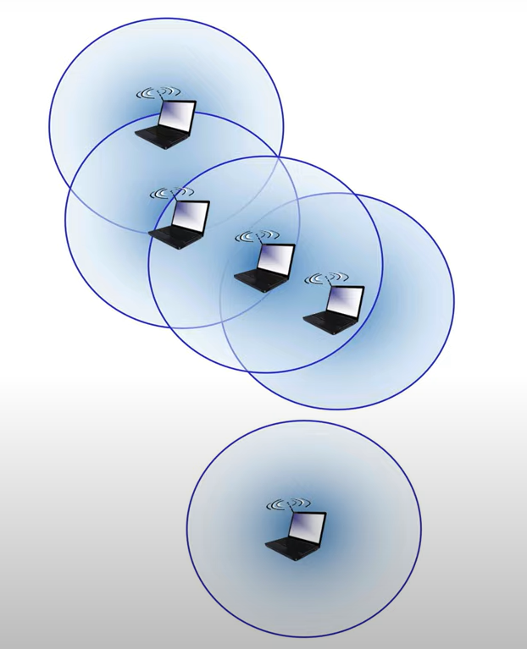
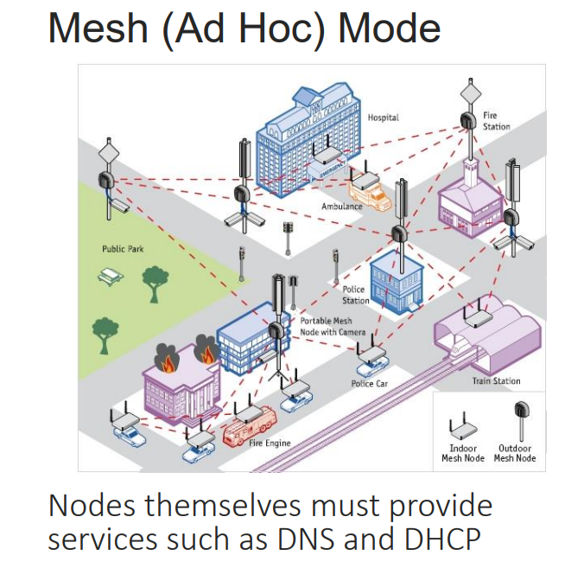
Elements of a wireless network
Ad hoc mode
No base stations
Nodes can only transmit to other nodes within link coverage
Nodes organize themselves into a network: route amongst themselves
This is advantageous where infrastructure may be damaged or not available

Slide 14
Wireless network taxonomy
single hop
multiple hops
host connects to base station (WiFi, cellular) which connects to larger Internet
host may have to relay through several wireless nodes to connect to larger
Internet: mesh net
infrastructure
(e.g., APs)
no base station, no connection to larger Internet (Bluetooth, ad hoc nets)
no base station, no connection to larger Internet. May have to relay to reach other a given wireless node MANET, VANET
no
infrastructure

Slide 15
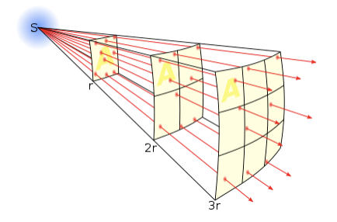
Wireless link characteristics: fading (attenuation)
Wireless radio signal attenuates (loses power) as it propagates (free space “path loss”)
Free space path loss ~ (fd)²
f: frequency
d: distance
higher frequency or longer distance
larger free space
path loss

Slide 16




Wireless link characteristics: multipath
multipath propagation: radio signal reflects off objects ground, built environment, arriving at destination at slightly different times
reflected path
line of sight
(LOS) path
reflected path

Slide 17
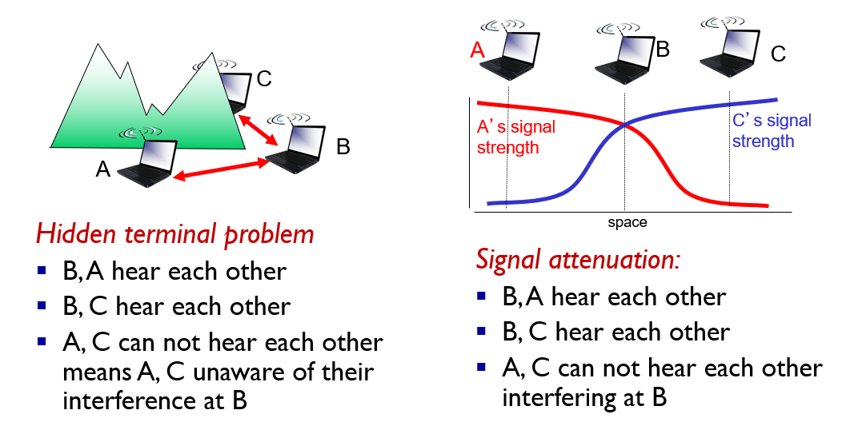
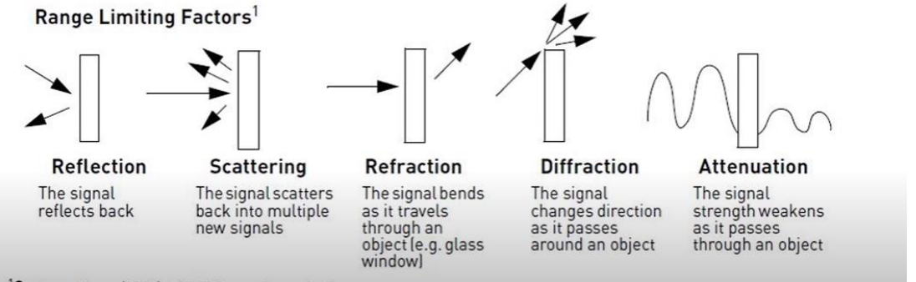
Wireless link characteristics: multipath
Important differences from wired link…
Decreased signal strength: radio signal attenuates as it propagates through matter (path loss)
Interference from other sources: wireless network frequencies (such as 2.4 ghz) shared by many devices will cause interferences
Multipath propagation: radio signal reflects off objects ground, arriving at destination at slightly different speeds
This makes wireless link communication much more challenging, compared to wired links

Slide 18
Wireless link characteristics: multipath
Wireless links have a threshold value they must operate over
→ If the wireless link does not meet this threshold, then a receiver cannot extract signal
10⁻¹
SNR: signal-to-noise ratio
Larger SNR – easier to extract signal from noise (more power) (good thing)
BER: Bit Error Rate
→ Large BER – data is corrupted more frequently
10⁻²
10⁻³
BER
10⁻⁴
10⁻⁵
SNR vs BER tradeoff
Given physical layer: increase power → increase SNR → decrease BER
Given SNR: choose physical layer that meets BER requirement, giving highest throughput
10⁻⁶
10⁻⁷
10
20
30
40
SNR(dB)
QAM256 (8 Mbps)
QAM16 (4 Mbps)
(encoding methods)
BPSK (1 Mbps)

Slide 19
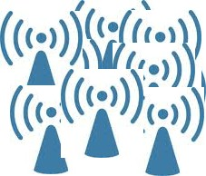
Shared Medium
Because wireless networks are sharing a medium/frequency, we need mechanisms for sharing bandwidth so that collisions don’t occur
In the link layer we have three types
1. TDMA (Time division Multiple Access)
2. FDMA (Frequency Division Multiple Access)
3. CDMA (Code Division Multiple Access)
Wired Networks
Wireless Networks

Slide 20
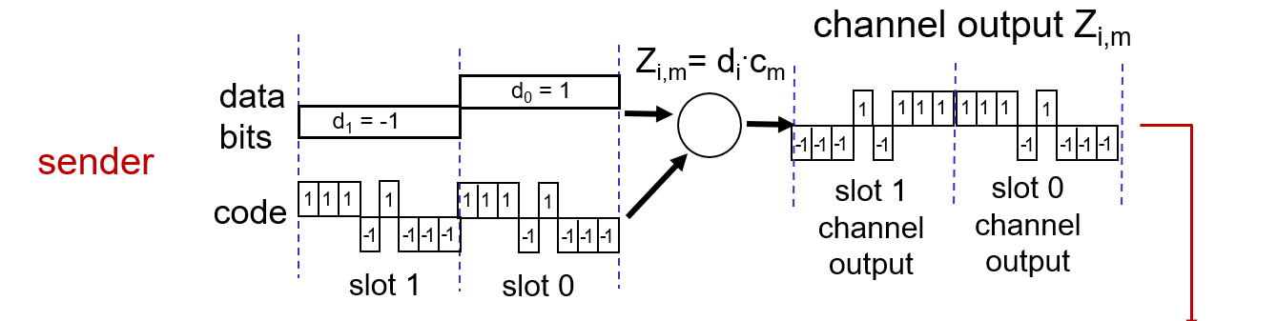
CDMA (Code Division Multiple Access)
All users transmit on the same frequency, but are assigned a unique code (chipping sequence)
In a CDMA protocol, each bit being sent is encoded by multiplying the bit by a signal (the code)
Encoding: inner product: (original data) * (chipping sequence)
Decoding: summed inner-product: (encoded data) * (chipping sequence)

Slide 21
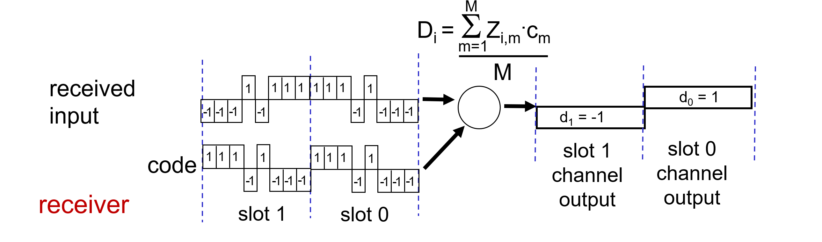

CDMA (Code Division Multiple Access)

Slide 22
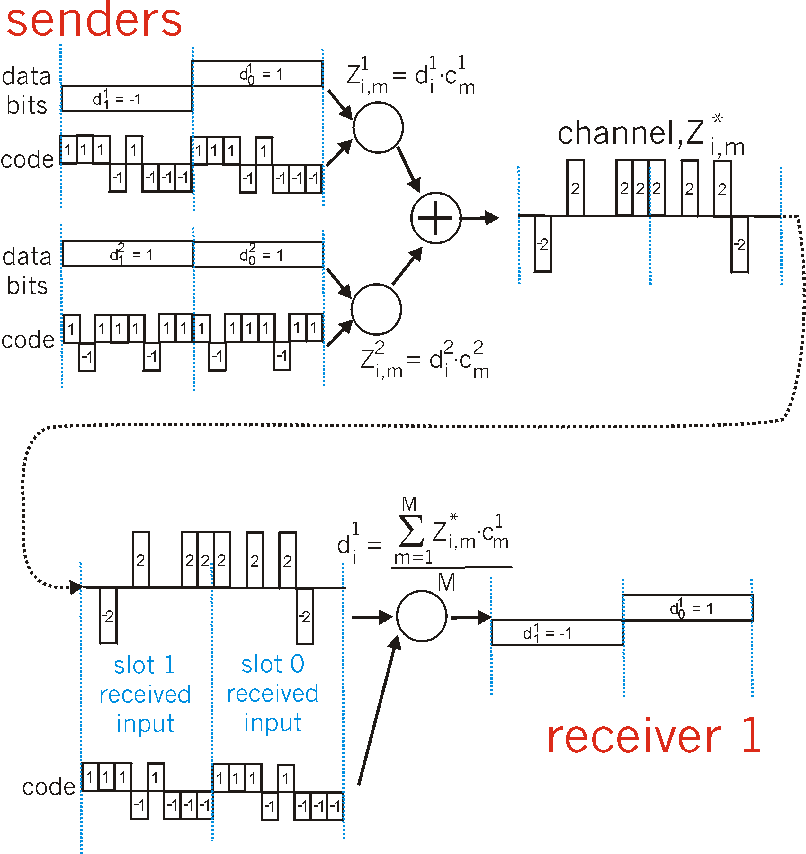
CDMA (Code Division Multiple Access) (Multiple Senders)
channel sums together transmissions by sender 1 and 2
Sender 1
Sender 2
using same code as sender 1, receiver recovers sender 1’s original data from summed channel data!
… now that’s useful!

Slide 23
IEEE 802.11 Wireless LAN
IEEE 802.11 standard | Year | Max data rate | Range | Frequency
802.11b | 1999 | 11 Mbps | 30 m | 2.4 Ghz
802.11g | 2003 | 54 Mbps | 30m | 2.4 Ghz
802.11n (WiFi 4) | 2009 | 600 | 70m | 2.4, 5 Ghz
802.11ac (WiFi 5) | 2013 | 3.47Gpbs | 70m | 5 Ghz
802.11ax (WiFi 6) | 2020 (exp.) | 14 Gbps | 70m | 2.4, 5 Ghz
802.11af | 2014 | 35 – 560 Mbps | 1 Km | unused TV bands (54-790 MHz)
802.11ah | 2017 | 347Mbps | 1 Km | 900 Mhz
all use CSMA/CA for multiple access, and have base-station and ad-hoc network versions

Slide 24





IEEE 802.11 Wireless LAN Architecture
Internet
wireless host communicates with base station
base station = access point (AP)
Basic Service Set (BSS) (aka “cell”) in infrastructure mode contains:
wireless hosts
access point (AP): base station
ad hoc mode: hosts only
switch
or router
BSS 1
BSS 2

Slide 25
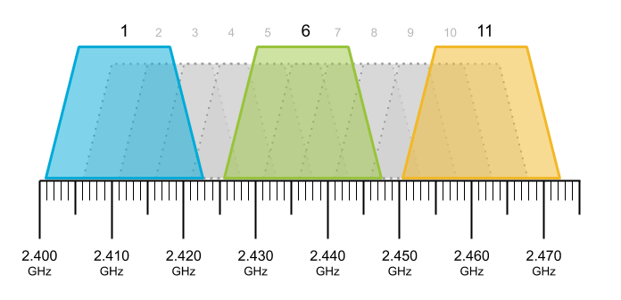
802.11: Channels
spectrum divided into channels at different frequencies
AP admin chooses frequency for AP
interference possible: channel can be same as that chosen by neighboring AP!
Example: 2.4 GHz

Slide 26
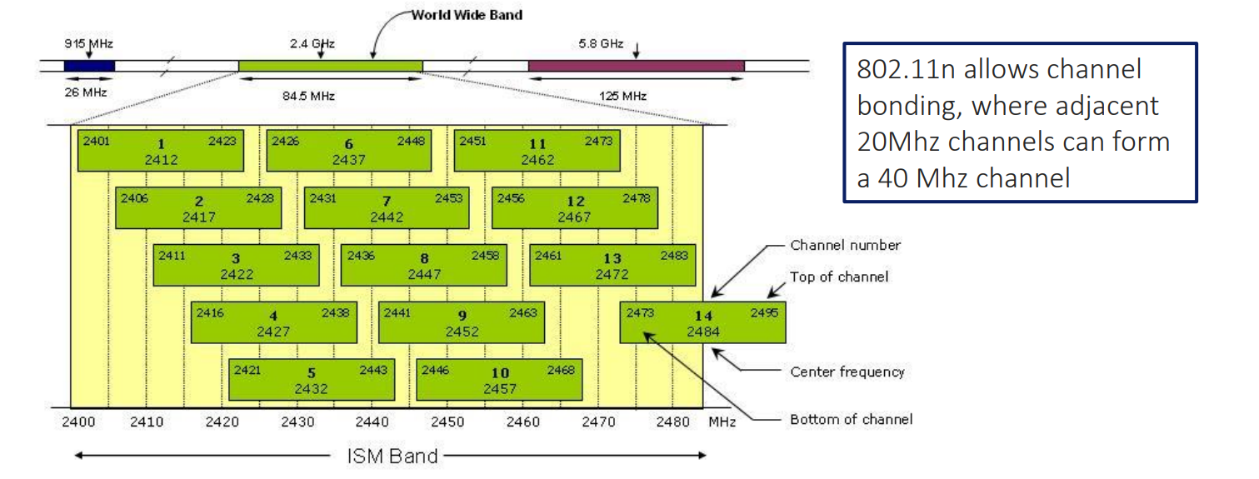
802.11: Channels

Slide 27
802.11: Association
arriving host: must associate with an AP
scans channels, listening for beacon frames containing AP’s name (SSID) and MAC address
selects AP to associate with
then may perform authentication
then typically run DHCP to get IP address in AP’s subnet
BSS

Slide 28
802.11: Association
BBS 1
BBS 2
BBS 1
BBS 2
1
1
AP 2
AP 1
1
AP 2
2
2
2
AP 1
3
3
4
H1
H1
passive scanning:
beacon frames sent from APs
association Request frame sent: H1 to selected AP
association Response frame sent from selected AP to H1
active scanning:
Probe Request frame broadcast from H1
Probe Response frames sent from APs
Association Request frame sent: H1 to selected AP
Association Response frame sent from selected AP to H1

Slide 29
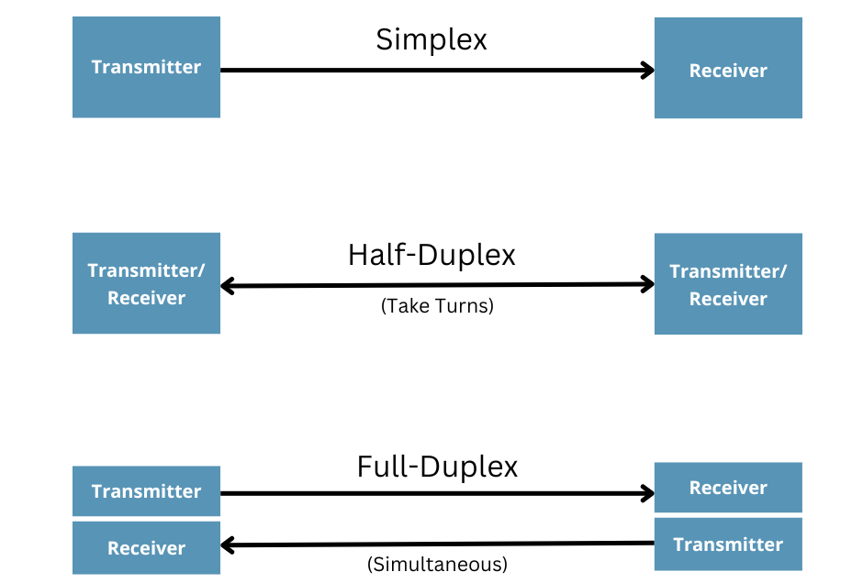
802.11: Association
In (wired) ethernet, we had MAC protocols that would listen on a channel, and only transmit if the channel was empty
→ Requires the ability to listen and transmit at the same time (full-duplex)
When WiFi begins to transmit a frame, it transmits the frame in its entirety; there is no going back
WiFi is not full-duplex, which means it cannot detect collisions, so we must avoid collisions instead

Slide 30




IEEE 802.11: multiple access
avoid collisions: 2⁺ nodes transmitting at same time
802.11: CSMA - sense before transmitting
don’t collide with detected ongoing transmission by another node
802.11: no collision detection!
difficult to sense collisions: high transmitting signal, weak received signal due to fading
can’t sense all collisions in any case: hidden terminal, fading
goal: avoid collisions: CSMA/CollisionAvoidance
A
B
C
C
B
A’s signal
strength
C’s signal
strength
A

Slide 31
IEEE 802.11 MAC Protocol: CSMA/CA
Distributed Inter-frame Space (DIFS)
Short Inter-frame Spacing (SIFS)
802.11 sender
1 if sense channel idle for DIFS then
transmit entire frame (no CD)
(time to wait before transmitting)
sender
receiver
DIFS
2 if sense channel busy then
start random backoff time
timer counts down while channel idle
transmit when timer expires
if no ACK, increase random backoff interval, repeat 2
data
SIFS
802.11 receiver
if frame received OK
return ACK after SIFS (ACK needed due to hidden terminal problem)
ACK

Slide 32
IEEE 802.11 MAC Protocol: CSMA/CA
idea: sender “reserves” channel use for data frames using small reservation packets
sender first transmits small request-to-send (RTS) packet to BS using CSMA
RTSs may still collide with each other (but they’re short)
BS broadcasts clear-to-send CTS in response to RTS
CTS heard by all nodes
sender transmits data frame
other stations defer transmissions

Slide 33

IEEE 802.11 MAC Protocol: CSMA/CA
A
B
AP
RTS(A)
RTS(B)
reservation collision
RTS(A)
CTS(A)
CTS(A)
time
DATA (A)
defer
ACK(A)
ACK(A)

Slide 34
IEEE 802.11 frame: addressing
2
2
6
6
6
2
6
0 - 2312
4
frame
control
duration
address
1
address
2
address
3
seq
control
address
4
payload
CRC
Address 1: MAC address of wireless host or AP to receive this frame
Address 4: used only in ad hoc mode
Address 3: MAC address of router interface to which AP is attached
Address 2: MAC address
of wireless host or AP
transmitting this frame

Slide 35
IEEE 802.11 frame: addressing
Once the AP gets the WiFi frame, it can convert it to a ethernet frame and send it through the main internet
Internet
H1
R1
802.3 Ethernet frame
R1 MAC addr
H2 MAC addr
MAC dest addr
MAC source addr
AP MAC addr
H1 MAC addr
R1 MAC addr
address 1
address 2
address 3
802.11 WiFi frame

Slide 36
IEEE 802.11 frame: addressing
duration of reserved
transmission time (RTS/CTS)
frame sequence # (for reliable data transfer)
2
2
6
6
6
2
6
0 - 2312
4
frame
control
duration
address
1
address
2
address
3
seq
control
address
4
payload
CRC
2
2
4
1
1
1
1
1
1
1
1
protocol
version
type
subtype
to
AP
from
AP
more
frag
retry
power
mgt
more
data
WEP
rsvd
frame type (RTS, CTS, ACK, data)

Slide 37
802.11: advanced capabilities
Rate adaptation
base station, mobile dynamically change transmission rate (physical layer modulation technique) as mobile moves, SNR varies
10⁻¹
10⁻²
10⁻³
BER
10⁻⁴
10⁻⁵
10⁻⁶
1. SNR decreases, BER increase as node moves away from base station
10⁻⁷
10
20
30
40
SNR(dB)
2. When BER becomes too high, switch to lower transmission rate but with lower BER
QAM256 (8 Mbps)
QAM16 (4 Mbps)
BPSK (1 Mbps)
operating point

Slide 38
Personal area networks: Bluetooth
“piconet”
less than 10 m diameter
replacement for cables (mouse, keyboard, headphones)
ad hoc: no infrastructure
2.4-2.5 GHz ISM radio band, up to 3 Mbps
master controller / client devices:
master polls clients, grants requests for client transmissions
C
P
P
radius of
coverage
M
C
C
P
P
M
master controller
client device
parked device (inactive)
C
P

